Slide 1
SQL Server 2016 R Services Deep-DivE
Christopher Boomhower, cboomhower@smu.edu
Alex Frye, amfrye@smu.edu
Lindsay Vitovsky, lvitovsky@smu.edu
MSDS 7330, Fall 2016

Slide 2
Agenda
The problem
What is SQL Server 2016 R Services?
Data Movement
Scale and Performance
Operationalization
Conclusion

Slide 3
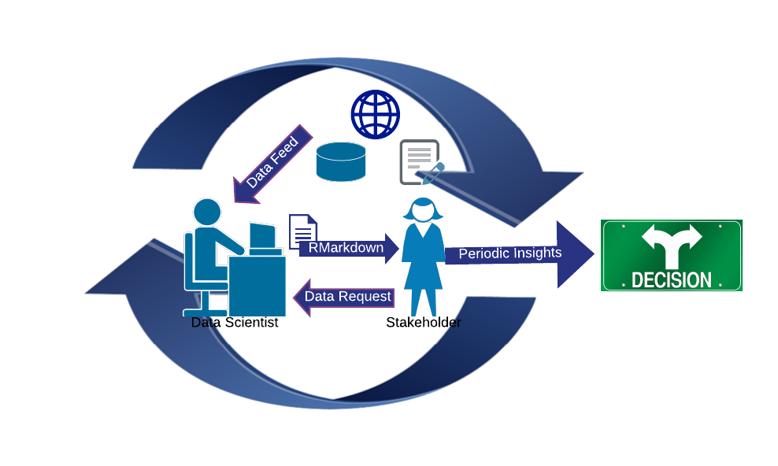
The problem
Risks:
Outdated information
Burdened database
Time consuming
Breach of data security

Slide 4
The problem
Data scientist cares about two main things:
Develop a more accurate understanding of a population
Be able to make predictions about a population
Balance meaningful results with large amounts of data

Slide 5
The problem
“But who cares about how much data you have? With too little data, you won’t be able to make any conclusions you trust. With loads of data you will find relationships that aren’t real.”
- D. Merrill, Ph.D

Slide 6


SQL Server 2016 R Services
Why R?
Advantages
Limitations
Why SQL Server?
Standard for RDBMSs
Query and store
+
(Images courtesy of R-project.org and Microsoft, 2016)

Slide 7
SQL Server R Services
What is R Services?
Integration for enterprise level data analytics
Data is kept at database – no transfer
Uses RevoScaleR package

Slide 8
Our system
Windows computer (version 8 or higher)
Reliable internet connection
SQL Server 2016 installation with SQL Server R Services enabled
db_datareader, db_datawriter privileges to the RServicesDemo Database
Microsoft R Server or Microsoft R Client for RevoScaleR package installation
All R packages installed in SQL server instance

Slide 9
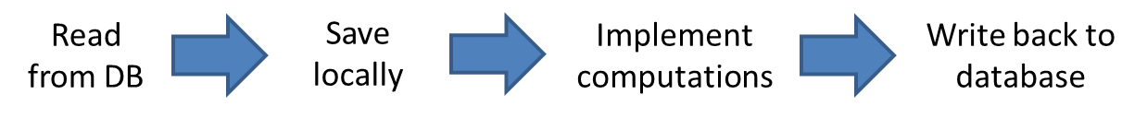
Data Movement
Existing resources
RODBC, RMySQL, ROracle, and RJDBC
Solves data transfer, but still just an interface.

Slide 10
Data Movement
Existing resources cont’d
Serial loading
Copying all records
Outdated if not timed right
Could expand the functionality of MySQL’s binary log

Slide 11

Data Movement
What makes R Services different?
Performs all computations at the same location as the data
Data science roles become more centralized, efficient, and cost-effective
(Image courtesy of Ron Leishman.com, 2016)
Notes:
By performing all computations at the same location as the data residing in the SQL Server 2016 database. As data storage/management becomes more integrated with data analysis via this approach, data science roles become more centralized, efficient, and cost-effective. These benefits culminate into a sustainable workflow within an organization, and this enhancement is founded upon data movement reduction and, therefore, increased speed.

Slide 12
Data Movement - test
Created a dummy data set of 10M records
Stored in SQL Server 2016
Consider write-backs to the database!
Traditional | New
Local instance of R | Microsoft R Services
Total time: 19m 52s | 1m 20s
Notes:
In order to test our theory of increased speed due to reduced need for data movement, we performed a simple experiment using a dummy data set containing 10 million records. These records were first stored within a SQL Server 2016 database. Next, all 10 million records were loaded into the R environment via two approaches and their completion times recorded. The first approach represents the traditional means of data analysis by pulling the data into an external, running instance of R, and the second represents the noted R Services approach of loading the data into an R instance running within the data’s database location. Loading a data set of this magnitude from a DBMS into an independent R process took 19 minutes and 52 seconds on our data science workstation.^{iv} Loading the same data from the same database, on the same workstation, into a R Services instance running at the data’s location within the database, completed in 1 minute and 20 seconds!^{v} Clearly, the R Services method using RevoScaleR takes the win for speed, and in turn, efficiency. Bear in mind that once the data is processed and analyzed it may very well require write-back to the database, extending the duration of data movement even further.

Slide 13
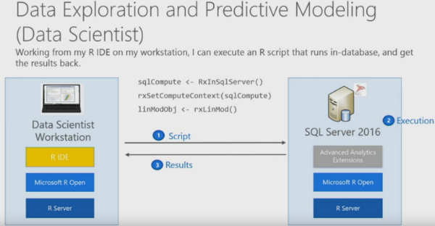
Data Movement
Installing SQL Server Enterprise on both “ends”…
(Microsoft Cloud Platform, 2016)

Slide 14
Data Movement
Drawbacks
R might not fit analysis desired
Still might not be fast enough in a world that wants “instant results”

Slide 15
Scale / Performance
R → main memory
Fast, but single threaded
Large datasets an issue
Cumbersome code
R Services addresses this by using SQL Server’s query optimization
Notes:
Of equal challenge to modern big data analyses is that of maximizing scalability and performance. On its own, the performance and speed of R is somewhat constrained as it depends heavily on the environment in which it is being used. R holds all objects in virtual memory, and depending on one's operating system, it might have limitations placed on it to the amount of resources that can be used at one time. When trying to process large datasets, or use a library with poorly written or cumbersome code, one can easily find himself/herself receiving error messages with R unable to obtain enough memory to process the needed computation.

Slide 16

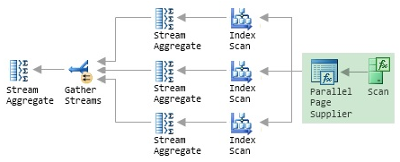
Scale / Performance
Simple query
Complex query
(Images courtesy of Paul White, 2011)

Slide 17
Scale / Performance
Parallel processing, managed automatically with RevoScaleR
Also configurable by the data scientist
numtasks
rowsPerRead
Still need more support for operationalization

Slide 18
Operationalization
The challenge = streamlining big data projects into production systems
Algorithms and models are typically created on the data scientist's workstation
Connected to DBMS systems, .csv files, or web data

Slide 19
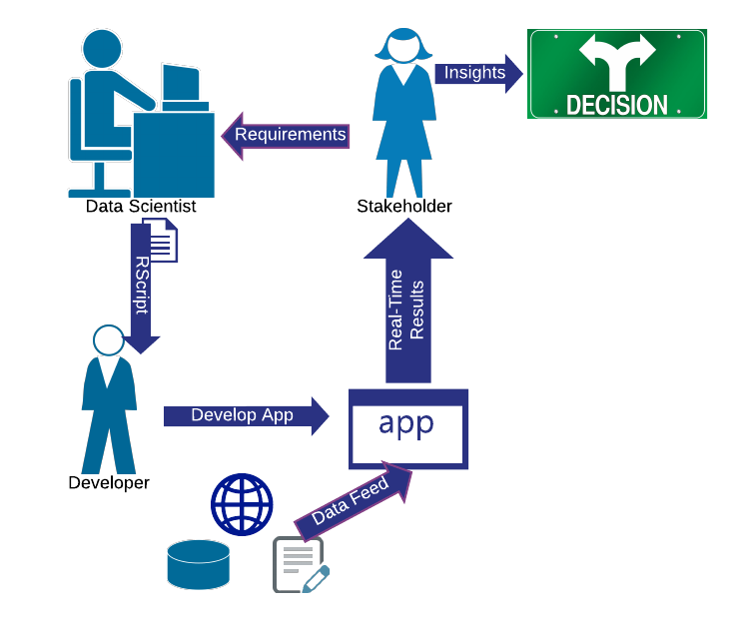
Operationalization - result
Results:
Data scientist can focus on adding new value, not as much on maintenance
Algorithms are built into the production process
Data is more secure

Slide 20
But operationalization is not a new concept.
Other methods
Ex., shinyapps, R.Net packages, command line batch scripts
Many still hinder system implementation or require re-write of the R script
So what makes R Services advantageous?

Slide 21
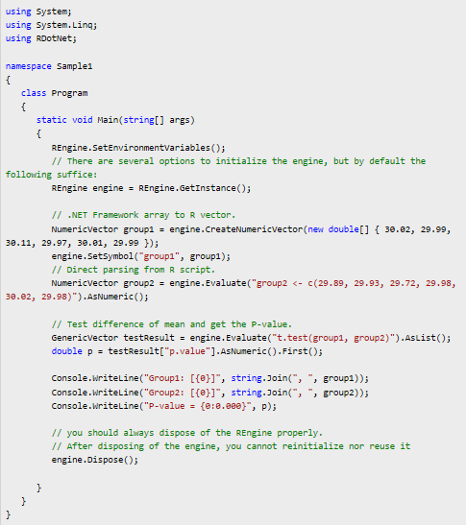
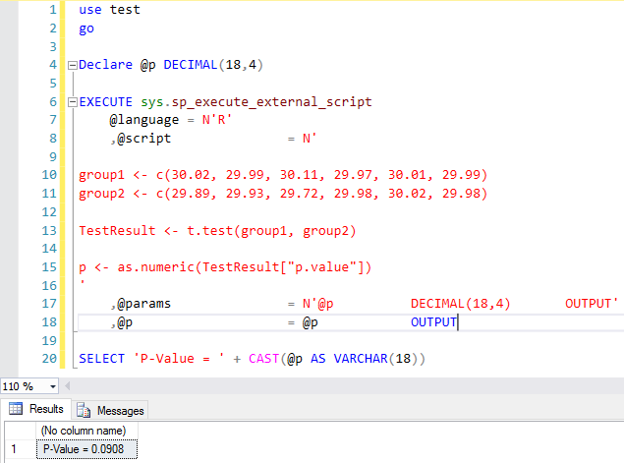
Operationalization w/ R Services
Example of R.net and C#
Example of SQL R Services

Slide 22
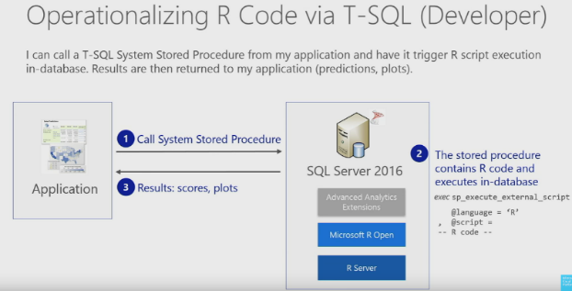
Operationalization w/ R Services
With R Services, the applications are capable of pushing all computations to the DBMS.
(Microsoft Cloud Platform, 2016)

Slide 23
Operationalization w/ R Services
Procedures can include R script, SQL data manipulation statements, and SQL data transformation statements all together
Output may include relational data values, R Model objects, plot graphics… generally any type of data that can be stored in an R variable.
To test this, our team performed a discriminant analysis on cancer data…

Slide 24
Operationalization w/ R Services Example
Performed Quadratic Discriminant Analysis on a dataset of > 500 tumors, classifying them as benign or malignant. R script included generating box plots of thirty variables.
Created a procedure to facilitate the execution of the R script.
R Services created a serialized value for the model and box plots, which was saved into the DBMS environment.
Created a procedure to facilitate retrieval of the R discriminant analysis from DBMS table. When called by a user, a report with submitted values and plots is generated.

Slide 25
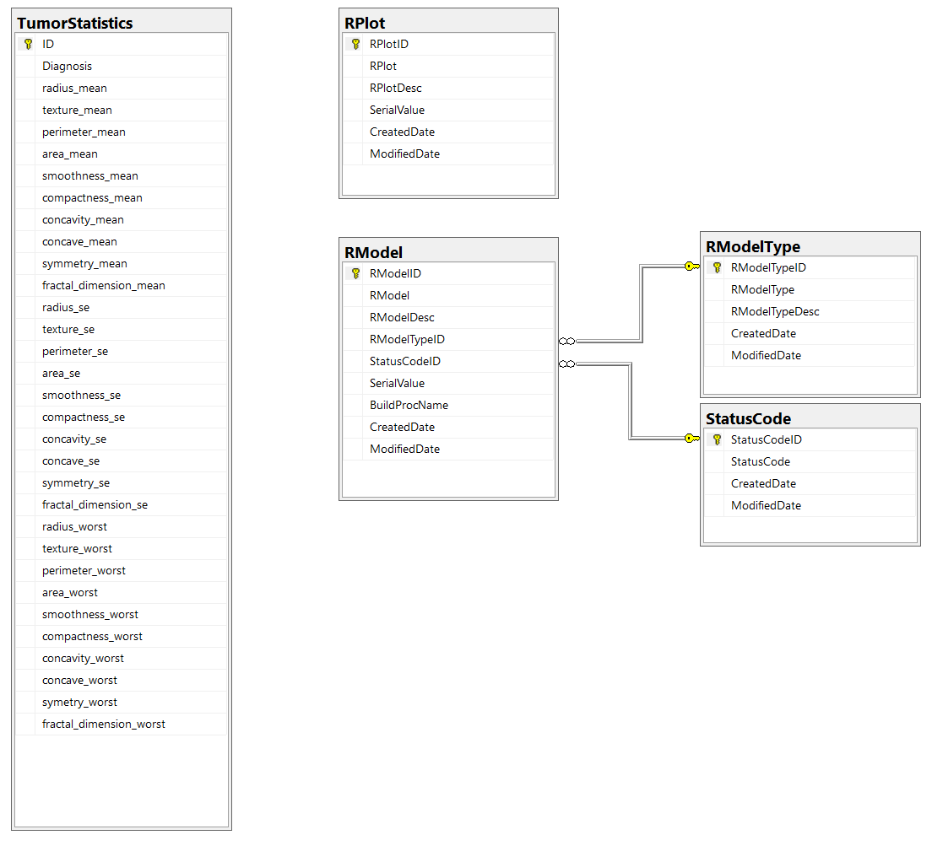
Operationalization w/ R Services - RServicesDemo DB Schema

Slide 26
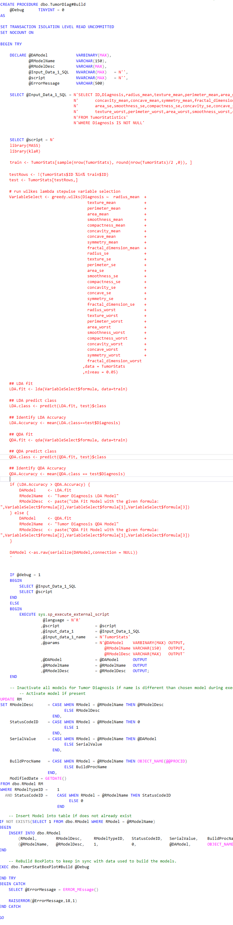
Operationalization w/ R Services - Build & Save the Model
1
Define Input Data SQL Query Statement
2
Define R Script code text for to build the Discriminant Analysis Model
2a
DAModel R variable contains Serialized Model Fit
3
sp_execute_external_script called. Inputs: @script, @Input_Data_1_SQL Outputs: @DAModel, @RModelName, @RModelDesc
4
Update RModel Table with Ccanges
4
Insert Rmodel Table if does not exist
5
ReBuild Boxplots to keep in sync with active model

Slide 27
1
Define Input Data SQL Query Statement
2
Define R Script code text for to build the Discriminant Analysis Model
2a
DAModel R variable contains Serialized Model Fit
3
sp_execute_external_script called. Inputs: @script, @Input_Data_1_SQL Outputs: @DAModel, @RModelName, @RModelDesc
4
Update RModel Table with Ccanges
4
Insert Rmodel Table if does not exist
5
ReBuild Boxplots to keep in sync with active model

Slide 28
1
Define Input Data SQL Query Statement
2
Define R Script code text for to build the Discriminant Analysis Model
2a
DAModel R variable contains Serialized Model Fit
3
sp_execute_external_script called. Inputs: @script, @Input_Data_1_SQL Outputs: @DAModel, @RModelName, @RModelDesc
4
Update RModel Table with Ccanges
4
Insert Rmodel Table if does not exist
5
ReBuild Boxplots to keep in sync with active model

Slide 29
1
Define Input Data SQL Query Statement
2
Define R Script code text for to build the Discriminant Analysis Model
2a
DAModel R variable contains Serialized Model Fit
3
sp_execute_external_script called. Inputs: @script, @Input_Data_1_SQL Outputs: @DAModel, @RModelName, @RModelDesc
4
Update RModel Table with changes
5
Insert RModel Table if does not exist
6
Rebuild Boxplots to keep in sync with active model

Slide 30
1
Define Input Data SQL Query Statement
2
Define R Script code text for to build the Discriminant Analysis Model
2a
DAModel R variable contains Serialized Model Fit
3
sp_execute_external_script called. Inputs: @script, @Input_Data_1_SQL Outputs: @DAModel, @RModelName, @RModelDesc
4
Update RModel Table with changes
5
Insert RModel Table if does not exist
6
Rebuild Boxplots to keep in sync with active model

Slide 31
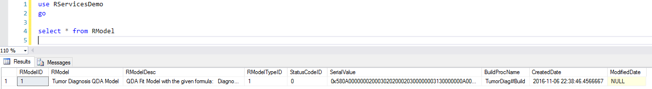
Operationalization w/ R Services - Build & Save the Model
Example Data in RModel Table

Slide 32
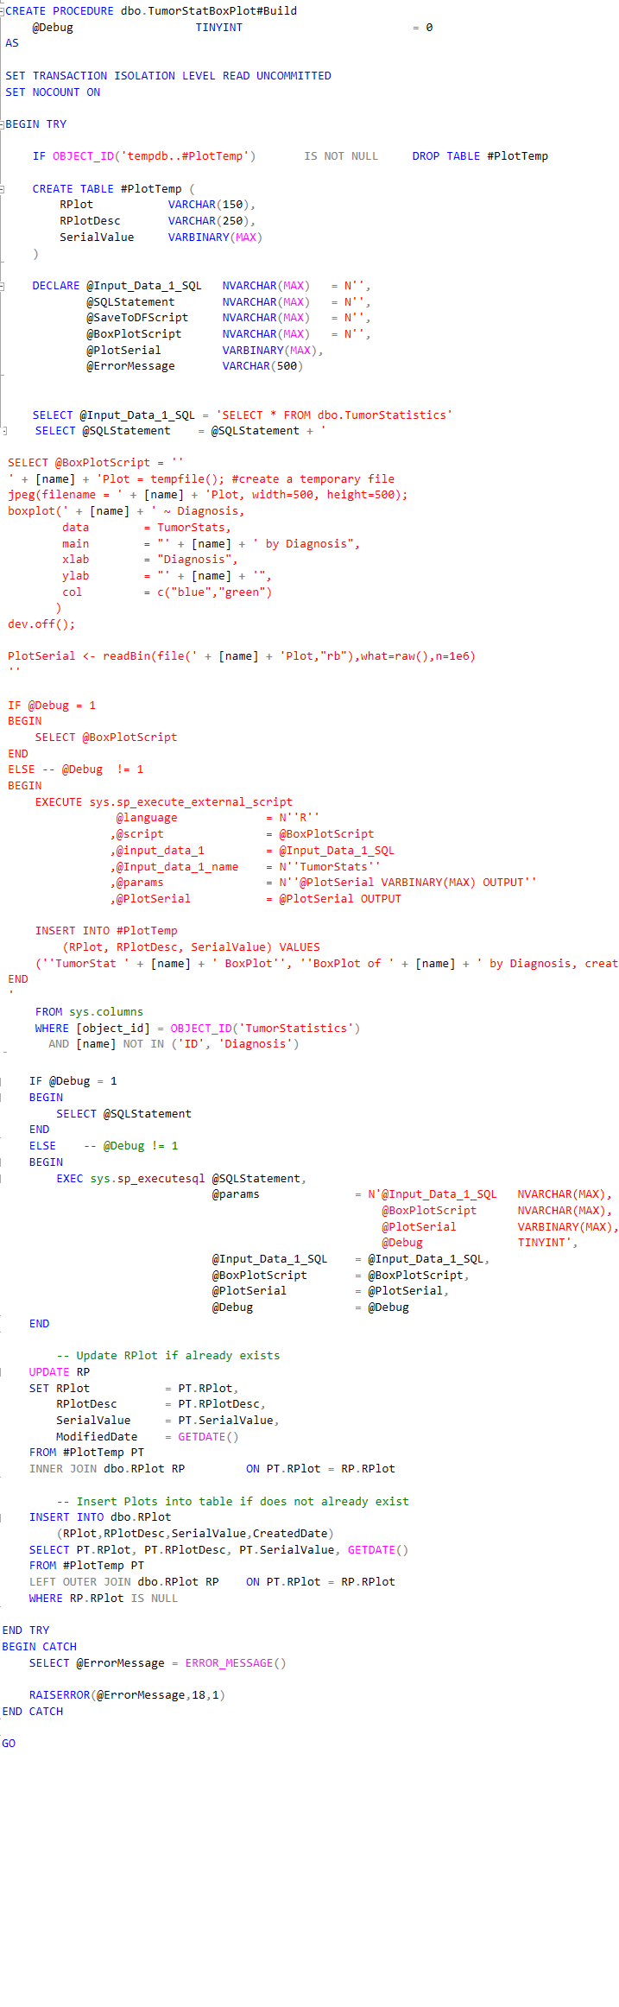
Operationalization w/ R Services - Build and Save Box Plots
1
Create Temporary Table to store R Script output values
2
Define Input Data SQL Query Statement
3
Generate Box Plot R execution statements dynamically for every explanatory variable
3a
Populate Temporary Table from each iteration of box plot serialized values
4
Execute dynamically generated SQL/R Script created
5
Update RPlot Table from Temporary Table Values
6
Insert RPlot Table from Temporary Table Values if does not exist

Slide 33
1
Create Temporary Table to store R Script output values
2
Define Input Data SQL Query Statement
3
Generate Box Plot R execution statements dynamically for every explanatory variable
3a
Populate Temporary Table from each iteration of box plot serialized values
4
Execute dynamically generated SQL/R Script created
5
Update RPlot Table from Temporary Table Values
6
Insert RPlot Table from Temporary Table Values if does not exist

Slide 34
1
Create Temporary Table to store R Script output values
2
Define Input Data SQL Query Statement
3
Generate Box Plot R execution statements dynamically for every explanatory variable
3a
Populate Temporary Table from each iteration of box plot serialized values
4
Execute dynamically generated SQL/R Script created
5
Update RPlot Table from Temporary Table Values
6
Insert RPlot Table from Temporary Table Values if does not exist

Slide 35
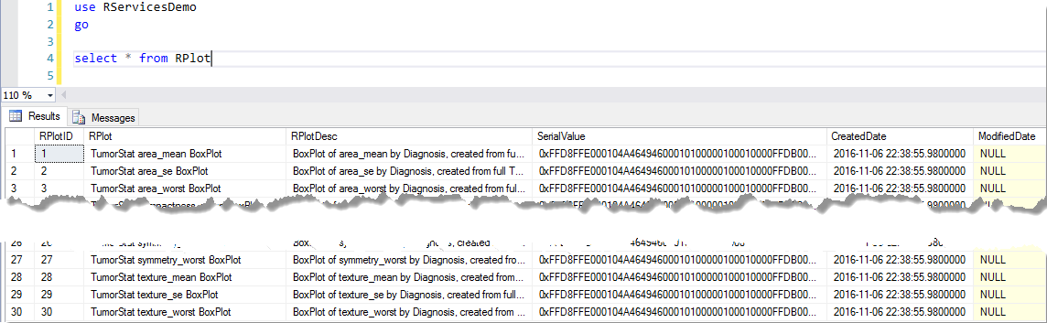
Operationalization w/ R Services - Build & Save the Model
Example Data in RPlot Table

Slide 36
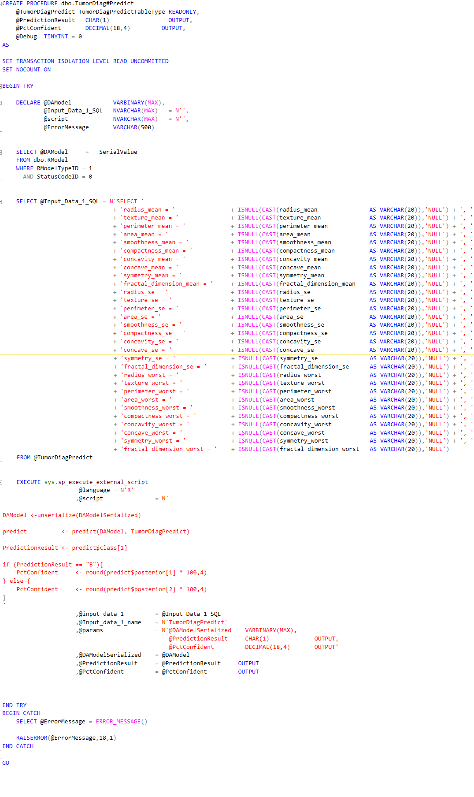
Operationalization w/ R Services - Tumor Prediction
1
Procedure Input:
Table Type with schema of all explanatory variables
Procedure Output:
@PredictionResult {B,M}
@PctConfident {% Probability from model}
2
Define @DAModel as SerialValue from Rmodel Table
3
Define Input Data SQL Query Statement from Table Type Input Values
4
Unserialize R Model; Execute Prediction
5
R Script Outputs: @PredictionResult, @PctConfident

Slide 37
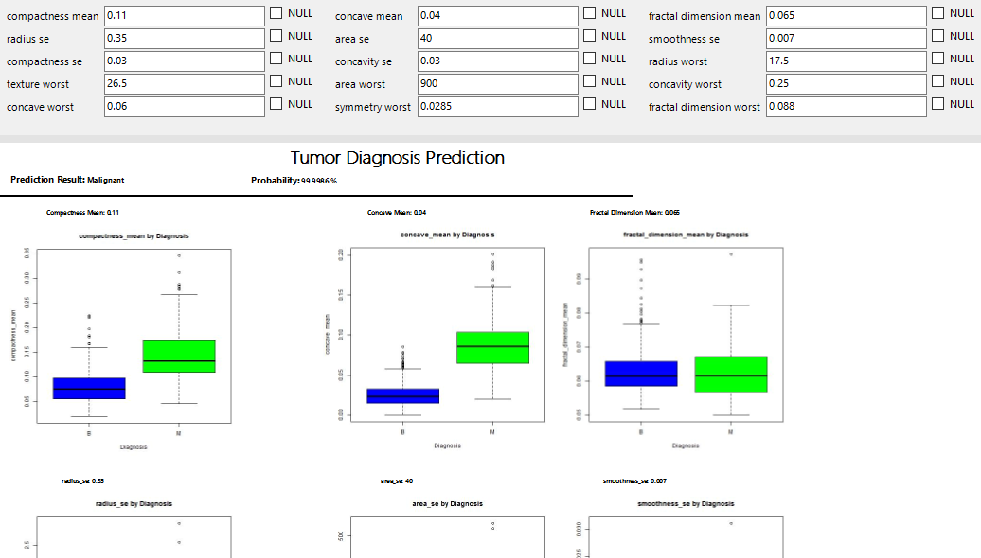
Operationalization w/ R Services - Tumor Diagnosis Prediction Report

Slide 38
Operationalization w/ R Services Example
Benefits:
Reduced data movement latency
Eliminated the need to build the model every time the model was needed.

Slide 39
Summary
R is not one-size fits all
Data movement – reduction in wait time
Scale / performance – advantage over existing packages
Operationalization – procedures are written to DB
Additional areas of impact: database developers, database administrators, and data engineers

Slide 40
R Services Demo Source Code
Available on GitHub
https://github.com/amfrye777/MSDS7330_RServicesDemo
Steps to Deploy:
Clone entire Repo
Open the .\01 - Deployment\01_Deploy.sql Script
Modify the @ServerName and RootPath Parameters per your SQL Installation and local repo root file location
Execute the .\01 - Deployment\01_Deploy.sql Script
Additional configuration needed to connect to the appropriate data source in the TumorDiagnosisPrediction Report

